Slide 1
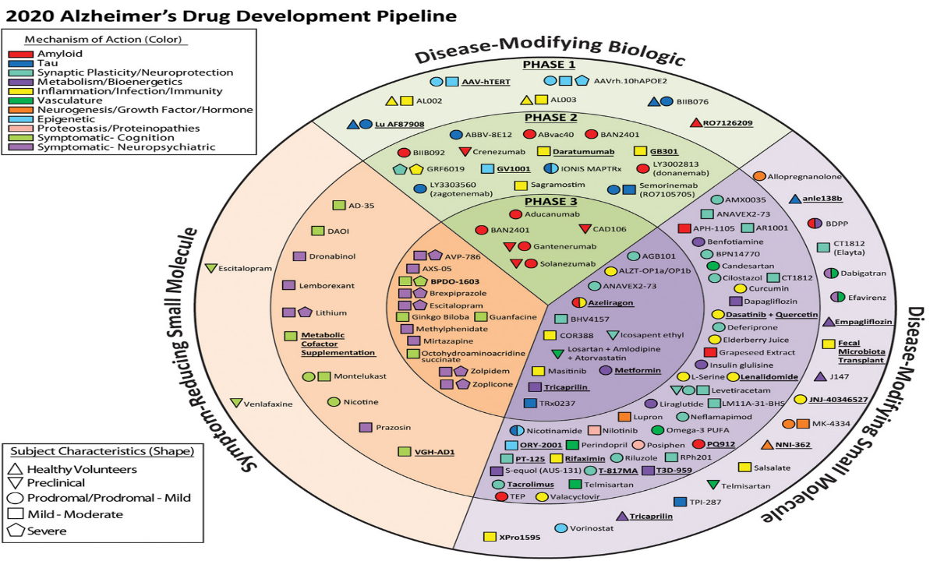

Slide 2
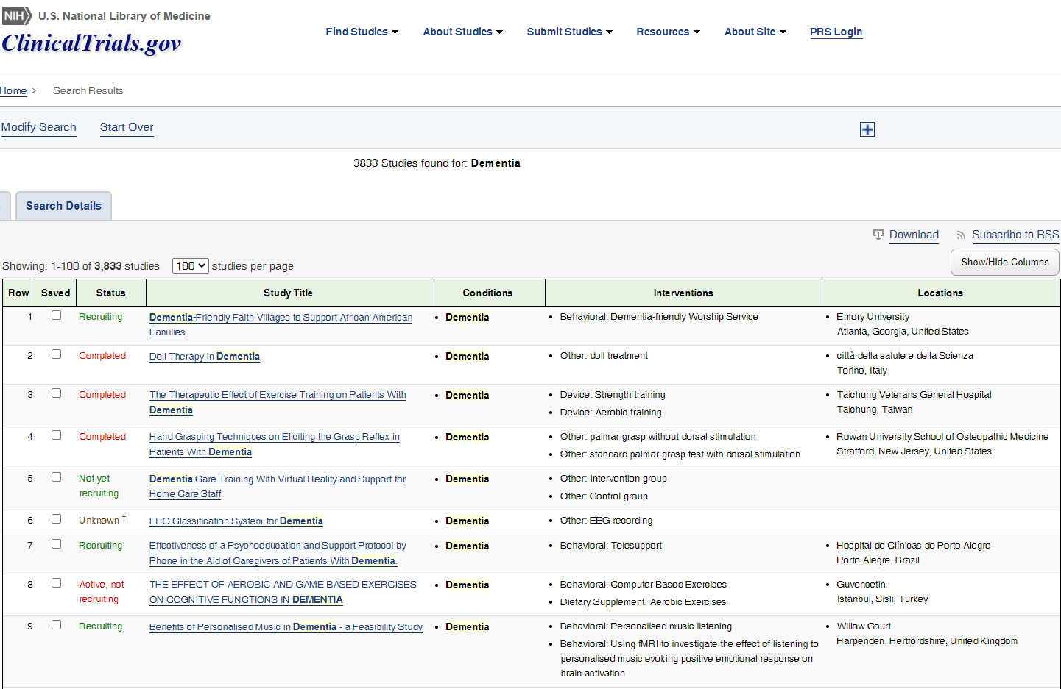

Slide 3
Phase I : First in man → safety
27 medications in 27 trials
Phase II : First in patient →dosing
65 medications in 73 trials
Phase III : Efficacy
29 medications in 36 trials
10% memory enhancing
10% symptom control
80% disease modifying

Slide 4
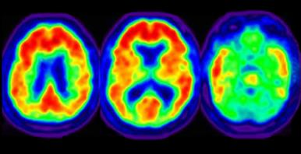
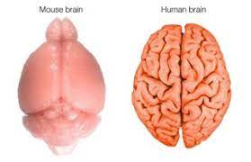
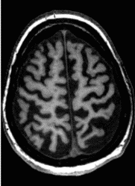
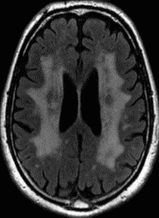

Slide 5
Pre-clinical research
First in patient studies
First in man studies
Pilot
studies
Large clinical trial(s)
Post licence surveillance
Recommended in guidelines

