Slide 1

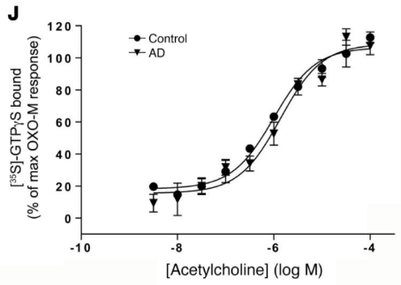
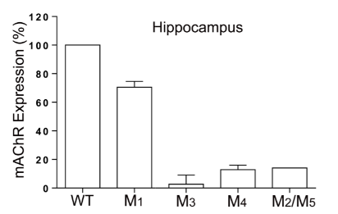
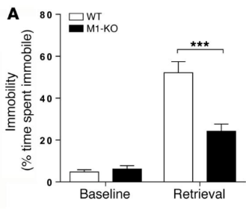
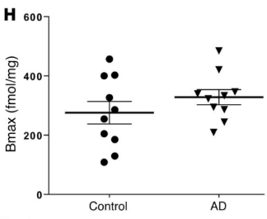
Targeting the M1 mAChR for AD therapeutics
Highly expressed in cortex and hippocampus
Involved in cognition
Receptor expression and signalling unaltered in AD
Bradley, S.J., et al.: J Clin Invest DOI: 10.1172/JCI87526 (2017).
Notes:
The M1 mAChR has long been a validated target for the treatment of neurodegenerative disorders for a number of reasons.
First of all, the M1 mAChR is the most predominant muscarinic subtype in the brain, and it’s highly expressed in the cortex and hippocampus which as I mentioned earlier are important for memory processes and are the most affected in AD
In addition, there is extensive evidence demonstrating the involvement of M1 mAChR in cognitive processes, for example as shown in this study from our lab, mice where the M1 mAChR was removed by genetic engineering, show significant cognitive impairments in a pavlovian fear-conditioning paradigm.
Importantly, AD was shown to cause the loss of pre-synaptic cholinergic neurons, the neurons that release ACh, and it has been shown that the expression and signalling of the M1 mAChR remain unaltered in disease, conferring an important advantage as a drug target.

Slide 2

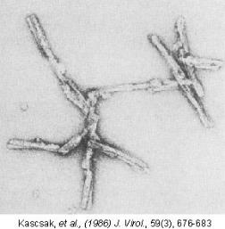
Preclinical models of disease
Crucial for behavioural observations
No perfect animal model of AD
The mouse prion disease model
Notes:
In order to test the therapeutic potential of a drug target, preclinical animal models of disease are important to see the effect of targeting your favourite protein, in our case the M1 receptor, on behaviour and symptoms.
It is important to highlight that there is no perfect animal model of AD, since animal do not naturally get AD, and therefore we rely in genetically engineer mouse models that express human disease-associated markers, or induced models.
In our lab we employ the mouse prion disease model which is the same disease that causes mad cow disease, but in mice. The mouse prion disease model offer many advantages to our research and shares many similarieties with AD. Fist of all this disease is also caused by toxic protein aggregates, scrapie prion, also causes memory impairments, a decrease in cholinergic signalling.

Slide 3
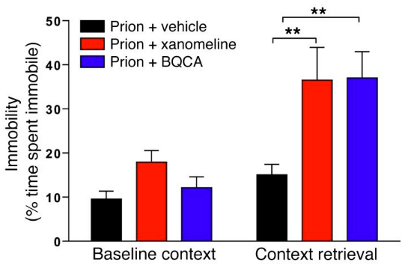
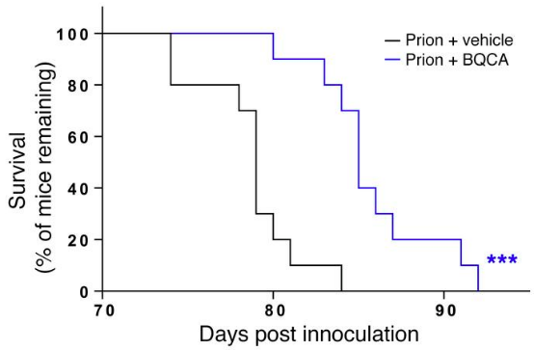
Targeting the M1 mAChR in mouse prion disease
Pharmacological activation of the M1 mAChR restores memory
M1 PAM BQCA slows down prion disease
  Symptoms and survival
  Disease markers
Bradley, S.J., et al.: J Clin Invest DOI: 10.1172/JCI87526 (2017).
Notes:
Using mouse prion disease, we were able to demonstrate that Administration of M1-activating ligands to prion-diseased mice can reverse cognitive deficits as demonstrated using fear-conditioning tests. This was shown using M1 activating ligands Xanomeline and BQCA.
But importantly, chronic treatment with the BQCA significantly extended the lifespan of terminally ill mice, establishing that M1-activating compounds have the potential to slow down neurodegeneration. This was not only shown in symptoms onset and survival of prion diseased mice, but also when we analyse the brains from these mice for disease markers, using biochemical methods and proteomics studies. Which I can talk to you more in detail if you are interested

Slide 4
Outline
Rationale
Target validation and preclinical studies
Pharmacology
Notes:
Next, I’d like to briefly talk to you about the importance of pharmacology studies for drug discovery

Slide 5
Targeting the M1 mAChR for AD therapeutics
Cognitive improvement in clinical (and preclinical) studies
Xanomeline (Eli Lilly and company) – Phase II
HTL0009936 (Sosei-Heptares) – Phase I
GSK1034702 (GlaxoSmithKline) – Phase I
Scarpa, M., et al.: Adv Pharmacol, 88, 277-310 (2020).
Notes:
So Activation of the M1 receptor has been shown in clinical trials to provide cognitive improvement in AD patients. Early studies were led by Eli lilly with their M1/M4-preferring orthosteric ligand xanomeline, that reached Phase II. Other clinical trials demonstrated improvements in cognitive symptoms, such as HTL0009936 by Sosei-heptares and GSK1034702 by GSK. However, all these are M1 orthosteric ligands, that cause some issues

Slide 6
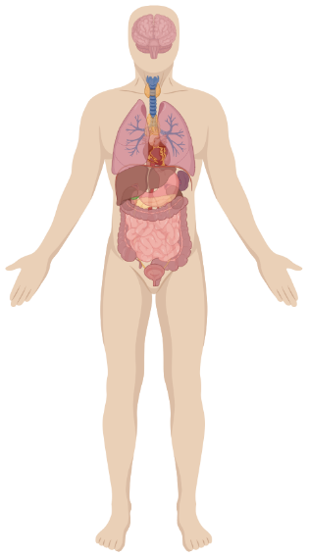
Issues with orthosteric ligands
N
Orthosteric ligands might lack of subtype selectivity
Need for subtype-selective ligands
M2
M1
N
C
N
M3
N
C
M4
C
M1 allosteric ligands
N
C
M5
C
Notes:
In fact, as many other recetor families, there are multiple muscarinic subtypes that all respond to the same neurotransmitter, acetylcholine, and therefore they all share the same binding pocket where acetylcholine binds, which is called orthosteric binding pocket.
Therefore, it is possible that when using M1 orthosteric ligands, that bind to the same pocket as ACh, these might activate peripheral muscarinic subtypes and cause the adverse responses that I explained earlier, the SLUDGE effect.
This has highlighted the need for subtype-selective ligands and that’s why we have been focussing on the use of M1 allosteric ligands, which activate the receptor by binding to allosteric binding pockets. By definition these pockets are different/separate from the pocket where acetylcholine binds and therefore they are not conserved across the subtypes. Therefore using pharmacological assays we are able to define the different characteristic of these ligands and ensure they only activate our preferred subtype before testing in preclinical disease models

Slide 7
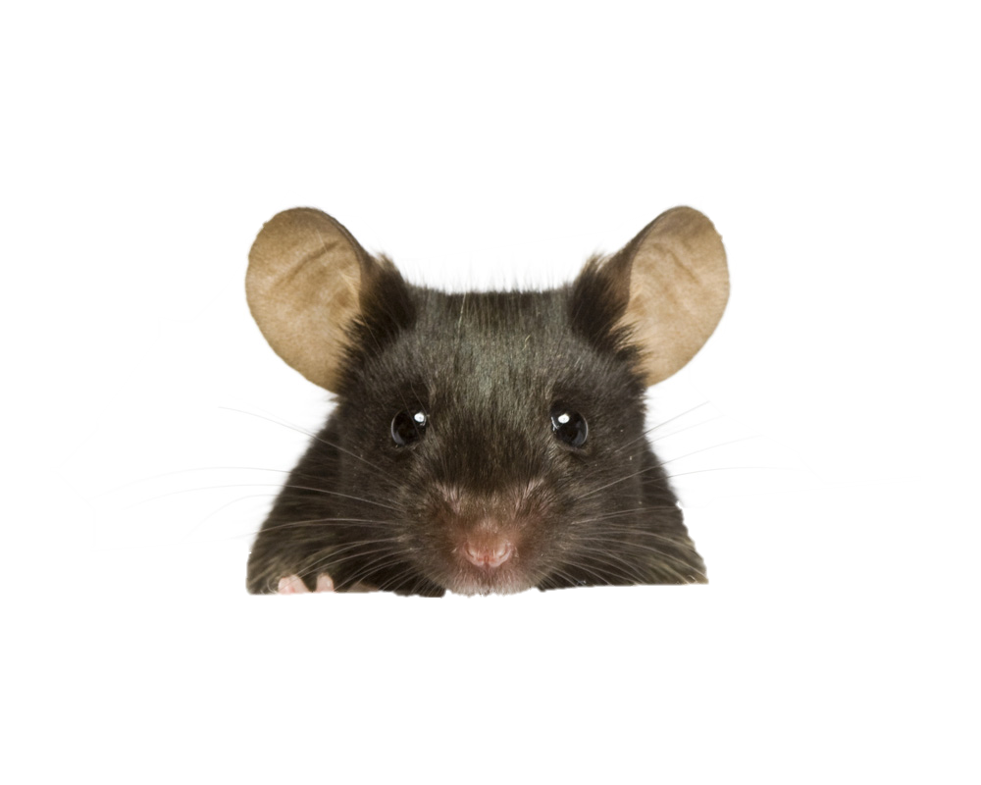



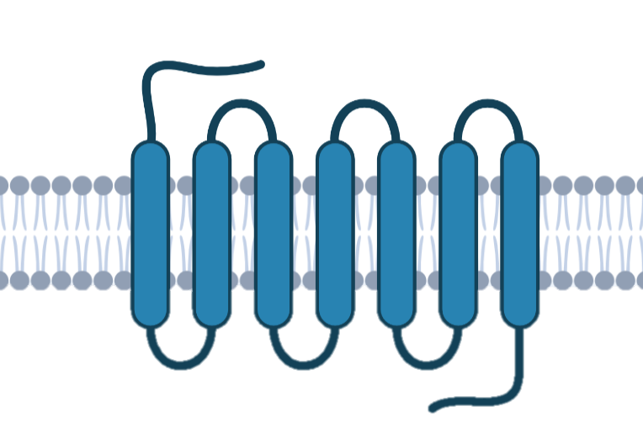





M1 mAChR signalling pathways
activation
G protein signalling
Neuroprotection
Good or bad?
Good or bad?
Phosphorylation/arrestin signalling
Notes:
In addition, in drug discovery programmes it is important to acknowledge that a receptor is able to activate multiple signalling pathways
If we compare the M1 receptor signalling to a clockwork motor, when activated by one specific ligand this might trigger a specific mechanism. While a different ligand might activate a different one. The question from here is which one of these mechanism induces the beneficial therapeutic effect?
In the case of the M1 receptor we know it activates either G protein signalling or phosphorylation/arrestin signalling, which we can measure in cells using different pharmacological assays.
What we did is that we removed the phosphorylation/arrestin pathways in mice and found that mice show accelerated prion disease. This experiment led to the discovery that the phosphorylation signalling provides neuroprotection in the brain and therefore M1 ligands that will ensure the activation of this mechanism specifically will more likely deliver the beneficial therapeutic effects

Slide 8
TAKE-AWAY POINTS
The M1 receptor is a promising drug target for the treatment of neurodegeneration
Research into molecular mechanisms can provide insights into disease and inform the design of effective medicines

Slide 9


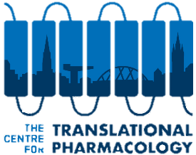

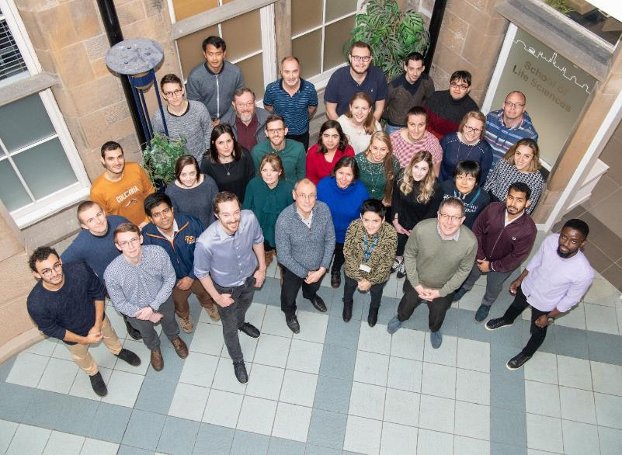


@miriamscarpa4
m.scarpa.1@research.gla.ac.uk
Centre for Translational Pharmacology
Sophie Bradley
Andrew Tobin
Colin Molloy
Lisa Finlayson
The rest of the team
Zeshan Ahmed (Lilly UK)
Lisa Broad (Lilly UK)
Thank you
for listening!
Notes:
Thank you everyone for listening, and I’d like to thank my supervisors Sophie and Andrew and everyone at the university of Glasgow Centre for Translational Pharmacology. And I’ll be happy to answer any questions here or offline.

