Slide 1







Treating dementia, what's next and how do we get there?
A fundamental scientist perspective
@miriamscarpa4
m.scarpa.1@research.gla.ac.uk
Alzheimer Scotland Annual conference 2021
Miriam Scarpa
Notes:
Hi everyone, my name is Miriam Scarpa and I am here to talk you about drug discovery from the perspective of a fundamental scientist

Slide 2
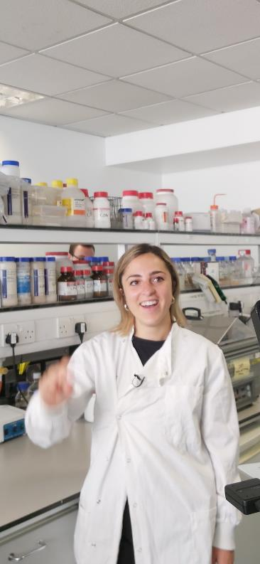

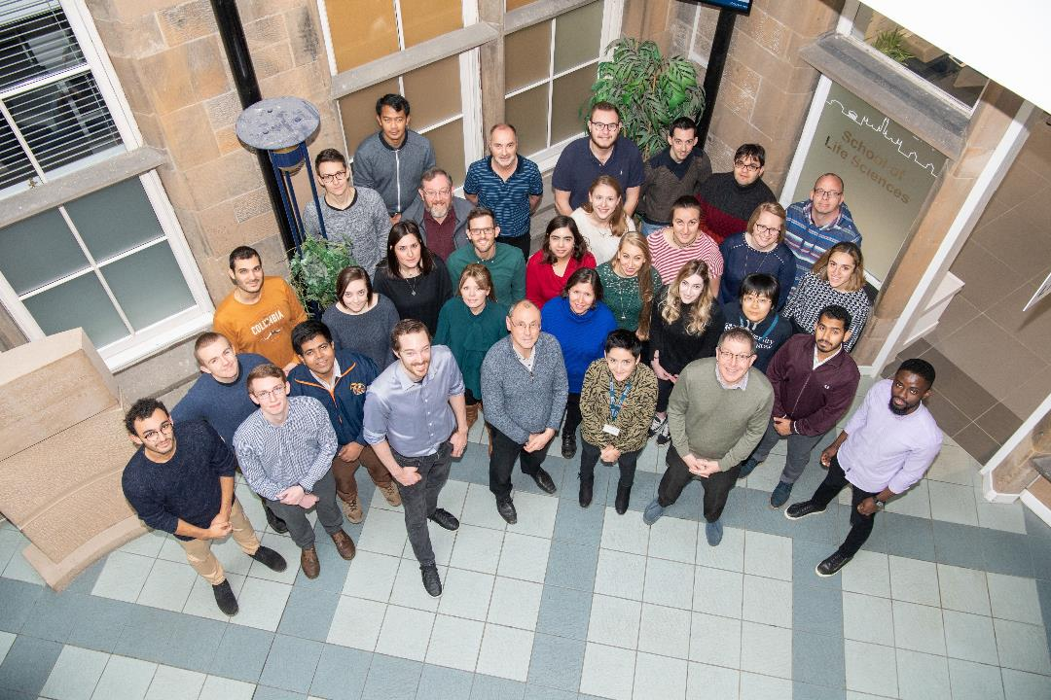
Notes:
I am a PhD student at the University of Glasgow centre for translational pharmacology. Our research focus on drug targets for the treatment of disease, including AD, and translate our findings into the clinics.

Slide 3

Outline
Rationale
Target validation and preclinical studies
Pharmacology
Notes:
I wish to take you through the process of drug discovery as fundamental scientists and will start from the rationale behind the choice of a certain drug target

Slide 4
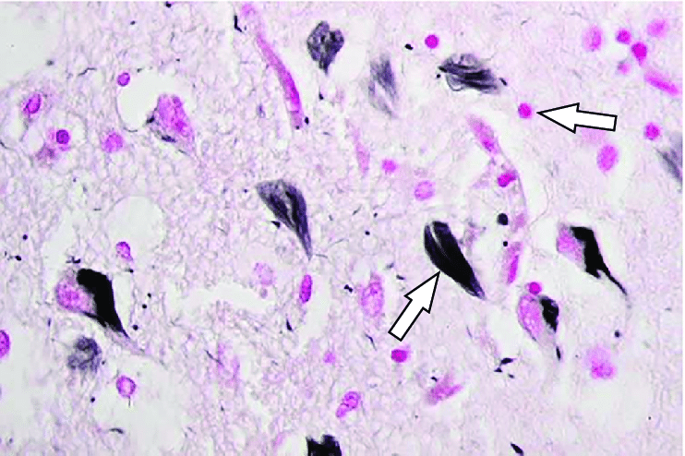
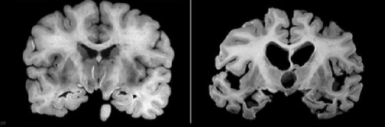
Alzheimer’s disease (AD)
Protein aggregates
Neurodegeneration
Cholinergic hypofunction
Plaque
NFT
Cortex
Hippocampus
Healthy
Alzheimer’s
Notes:
AD is characterised by the presence iin the brain of toxic aggregates formed by misfolded proteins such as Abeta plaques and NFT.
AD is a neurodegenerative condition, meaning that it causes the progressive loss of brain cells, the neurons resulting is the shrinkage of the brain tissue as you can see in these images. In particular, neurodegeneration is usually found in the hippocampus and the cortex which brain regions that play key roles in learning and memory
In addition, AD is characterised by cholinergic hypofunction, which is the decrease in cholinergic signalling caused by the selective loss of cholinergic neurons

Slide 5
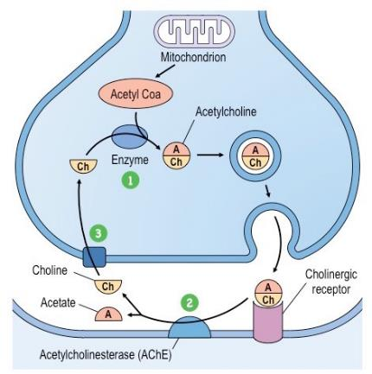
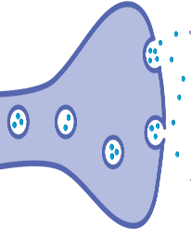



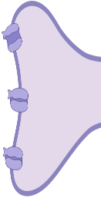
Cholinergic hypofunction in AD
Selective loss of cholinergic neurons
Current treatments aim to stabilise cholinergic signalling
Acetylcholine
Cholinergic receptors
(muscarinic or nicotinic)
Healthy brain
Memory
Alzheimer’s brain
Notes:
Cholinergic neurons are neurons communicate/signal using the neurotransmitter acetylcholine that binds to and activates cholinergic receptors that include muscarinic and nicotinic receptors, at the synapse, the communication interface between neurons.
In the brain, when cholinergic receptors are activated by acetylcholine, their signalling ultimately contribute to the generate and store memory.
However in the brain of AD patients, the neurons releasing Acetylcholine are lost due to neurodegeneration, decreasing cholinergic signalling and causing memory impairments that are typical of AD
And the current treatment available for AD and other forms of dementia aim to stabilise the levels of ACh in the brain.

Slide 6
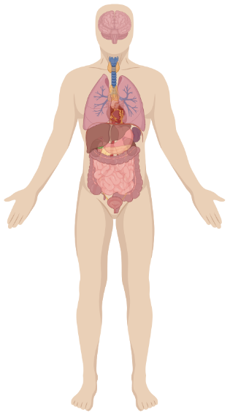
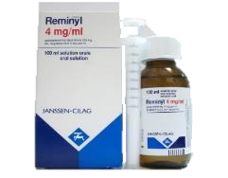
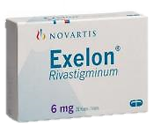
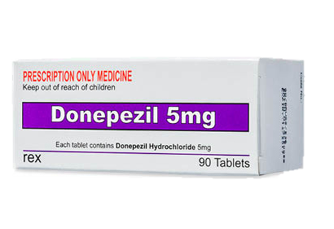
AD therapeutics
M1
S
alivation
L
acrimation
U
rination
D
iarrhoea
G
I discomfort
E
mesis
AChE inhibitors
Notes:
In fact, the frontline medications available are AChEI prevent, that act on AChE to prevent the breakdown of Ach at the synapse thereby potentiating Ach signalling
However, AChEI only provide symptomatic relief and only have effects on mild to moderate AD whereas they stop working after the disease is progressed after a certain point.
Moreover, cholinergic receptors are present throughout the whole body, causing a systemic upregulation of the cholinergic signalling leading poorly-tolerated off-target adverse effects, which are so awful that they are summarised by the acronym SLUDGE
However, Our group, and many others, have been focussing on the M1 subtype muscarinic receptor as drug target for selective pharmacological treatment for AD

Slide 7

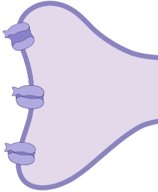
Alzheimer’s brain
+ M1 receptor drug
Memory
Notes:
Therefore the rationale is to use medicines that selectively activate the M1 receptors in the brain for the treatment of dementia and AD

Slide 8
Outline
Rationale
Target validation and preclinical studies
Pharmacology

